Slide 1
Perform data collection and preprocessing tasks.
By: Choy Chengfeng
ID: H9990081A

Slide 2
Problem Statement (4Ws)
What is the problem relating this project.
Who | Singapore Tourism Board (STB) and hotel operators who need to plan resources and marketing strategies
What | Predict international visitor arrivals and hotel arrivals
Where | Singapore’s hotel and tourism sector
Why | Identify patterns in historical tourism and hotel data to predict visitor arrivals for capacity planning, resource allocation, and marketing decisions.

Slide 3
Part 1

Slide 4
Data Sources
Data Collected: Monthly tourism arrivals and hotel statistics merged on date to create a unified time-series dataset.
Primary API | Secondary API
Source: Singapore Tourism Board (data.gov.sg) | Source: Singapore Tourism Board (data.gov.sg)
Dataset: International Visitor Arrivals by Place of Residence (Monthly) | Dataset: Singapore Tourism Integrated
Time Period: 2008–2026 | Time Period: 2008–2026
Key Columns: Date, , Arrivals Count | Key Columns: Date, Average Occupancy Rate, Room Revenue, Gross Lettings, Available Room Nights

Slide 5
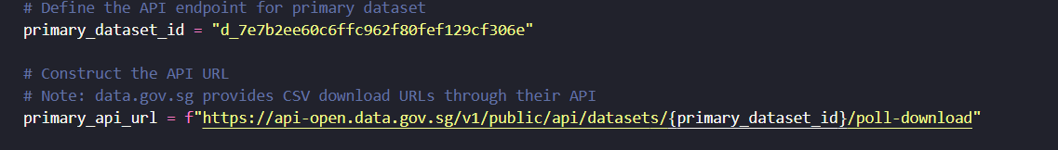
APIs obtained
Primary API:
Secondary API:

Slide 6
Part 2

Slide 7
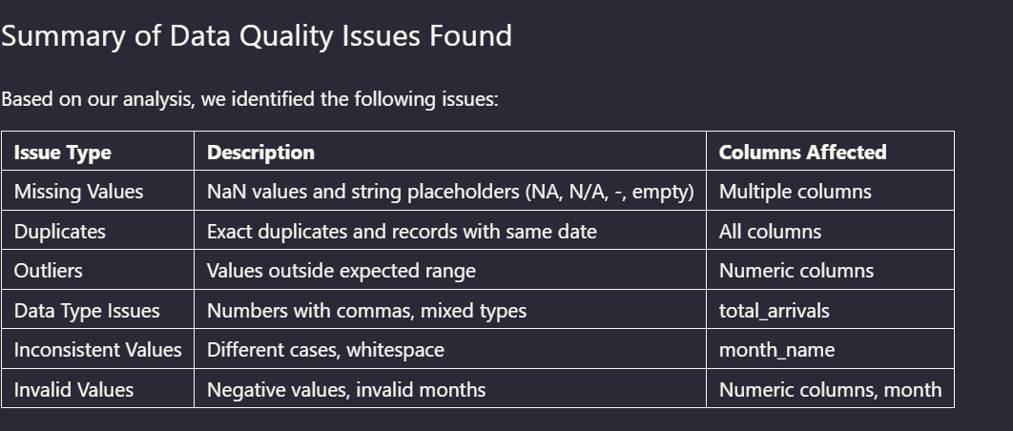
Data Quality Issues

Slide 8
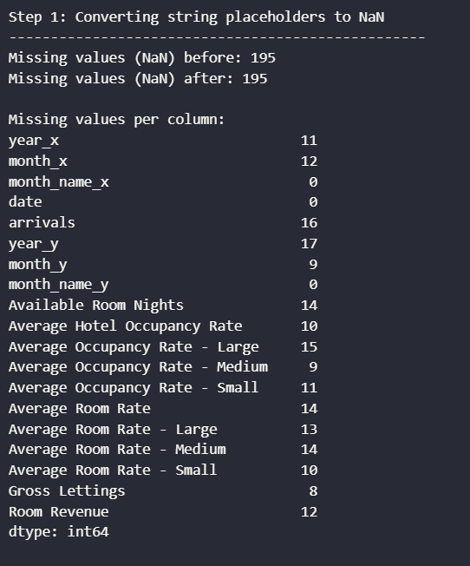
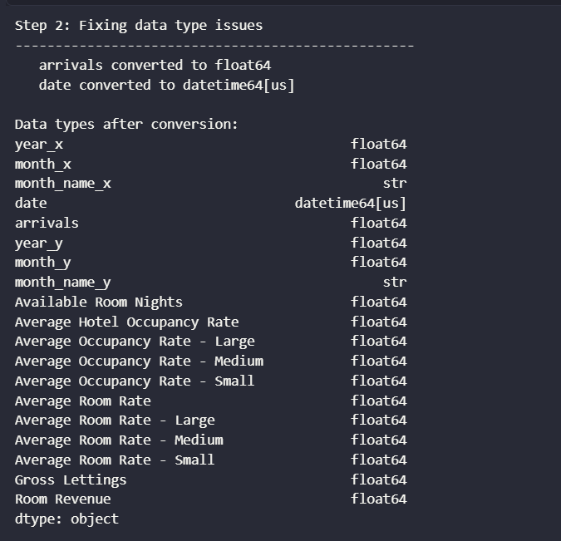
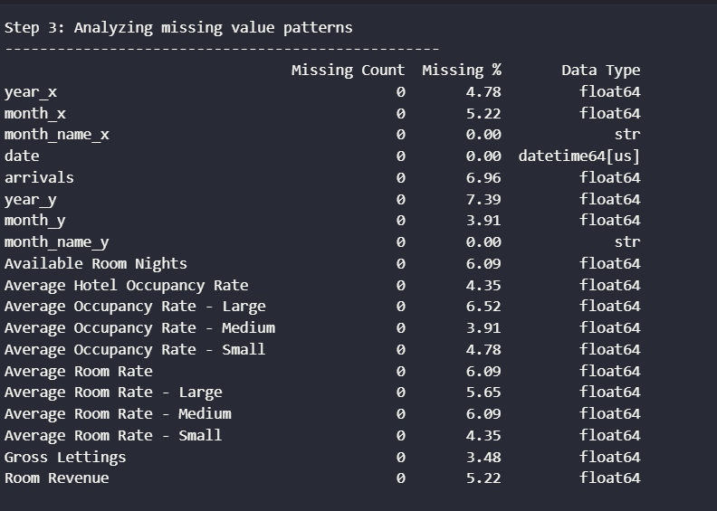
How I handled them
Missing Values

Slide 9
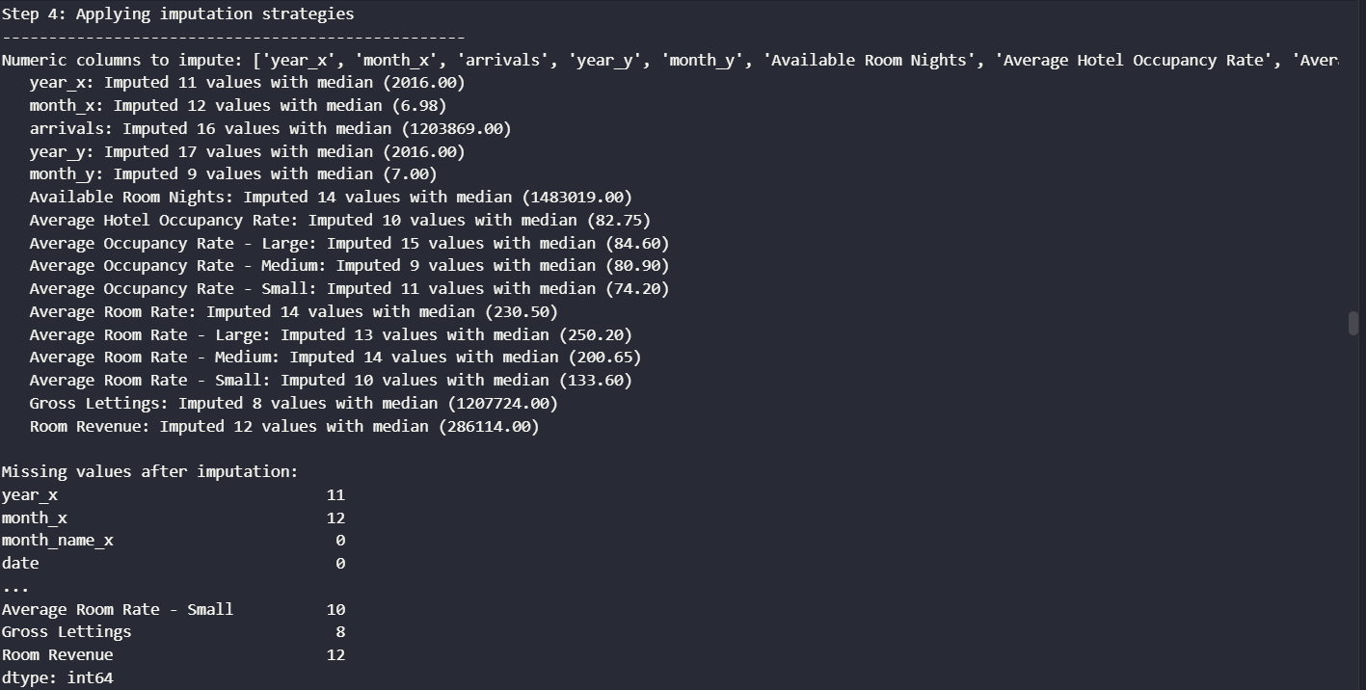
Missing Values handling

Slide 10
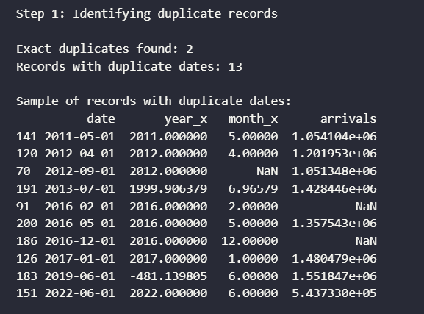
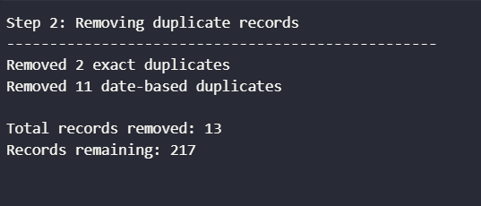
How I handled them
Duplicates

Slide 11
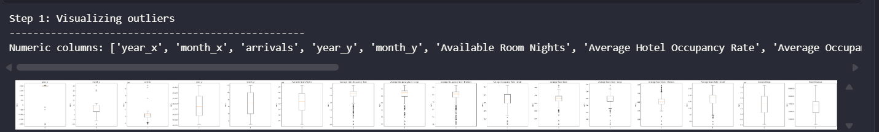
How I handled them
Outliers. I visualize first

Slide 12
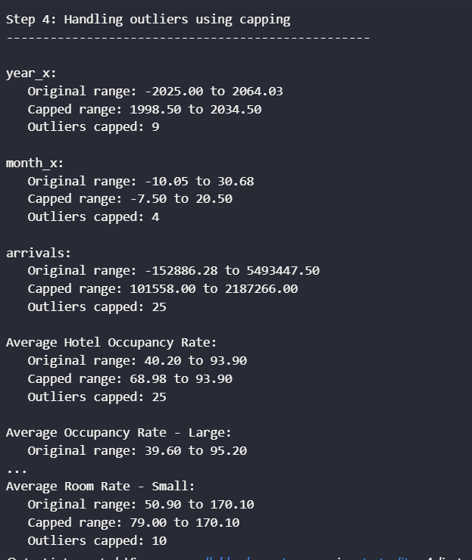
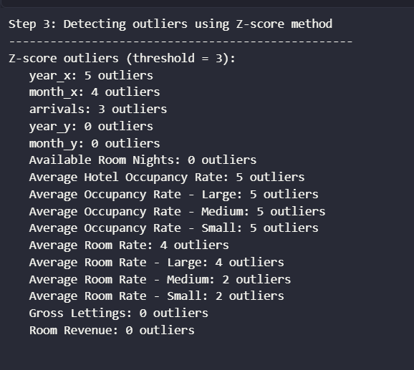
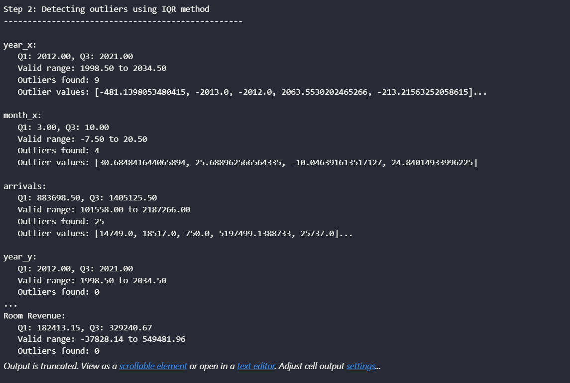
How I handled them
Outliers continous

Slide 13
Part 3

Slide 14
Feature Engineering
Why Feature Engineering Matters:
Raw data only tells "what" happened. Engineered features tell the model "why" and "how" it happened

Slide 15
Feature Engineering
Features created
Feature Type | Features Created | Business Purpose
Lag Features | arrivals_lag_1, arrivals_lag_3 | Capture momentum—what happened last month/quarter.
Moving Averages | arrivals_ma_3, arrivals_ma_6 | Smooth short-term noise to reveal underlying trends.
Growth Rates | YoY Growth, MoM Change | Capture trends and acceleration/deceleration.
Ratio Features | Arrivals to Occupancy, Arrivals to Room Nights | Capture supply-demand balance and crowding pressure.
Seasonal Indicators | Peak Season Flag, Month, Quarter | Capture cyclical patterns (holidays, school breaks).

Slide 16
Feature Selection
Feature Selection Process:
Correlation Analysis: Identified features with strong correlation to target.
Threshold Selection: Kept features with correlation.

Slide 17
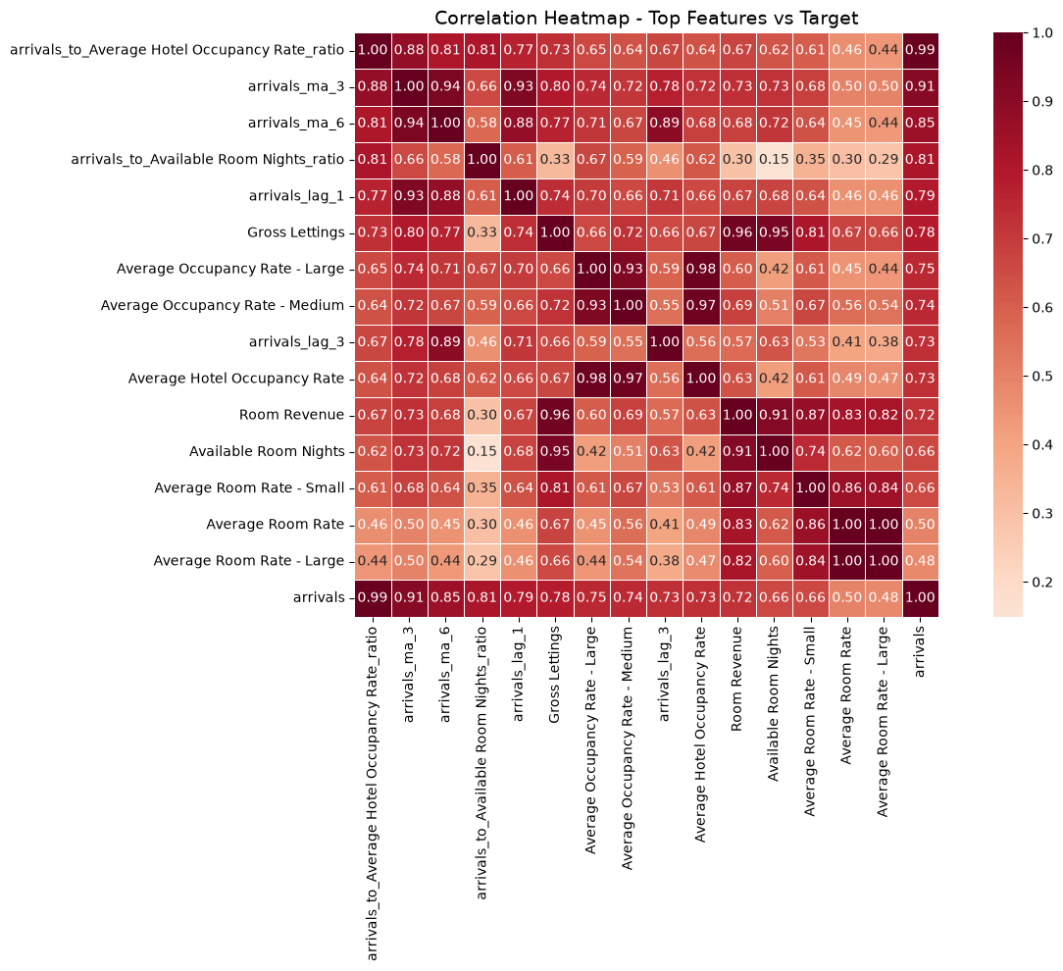
Correlation Heatmap

Slide 18
Correlation Heatmap
Top Predictors | Correlation with Target | Interpretation
arrivals_ma_3 | 0.91 | Many arrivals in the average of last 3 months.
arrivals_ma_6 | 0.85 | The past 6 months the arrivals are not bad as well.
arrivals_available_room_nights_ratio | 0.81 | Supply demand pressure, more tourists per available room
arrivals_lag_1 | 0.79 | Last months arrival should be continued in this month
Gross_Lettings | 0.78 | Crowdedness metric—how full are hotels per night

Slide 19
Feature Importance
The model identified moving averages (3-month and 6-month) as the most important predictors, confirming that underlying trends matter more than short-term fluctuations. Lagged features also played a key role, showing that tourism has strong momentum—past arrivals influence future arrivals. Engineered ratio features—such as arrivals to available room nights—captured supply-demand pressure, highlighting how hotel capacity constraints affect tourist flows.

Slide 20
Part 4

Slide 21
Model results
Model Comparison
Linear Regression is always the third worst model in my prediction.
While Decision Tree works best on R2 score performance score of 0.904, and third best for MAE, RMSE and R2 score overfitting. Score of 28.2
Billion, 98.4 K respectively. Opposite from Linear Regression
Random Forest is my best model here. Tops R2 score, RMSE and
R2 overfitting. Only comes third best for MAE.
Performance metrics
R² – Higher is better.
RMSE – Lower prediction error is better.
MAE – Lower average error is better

Slide 22
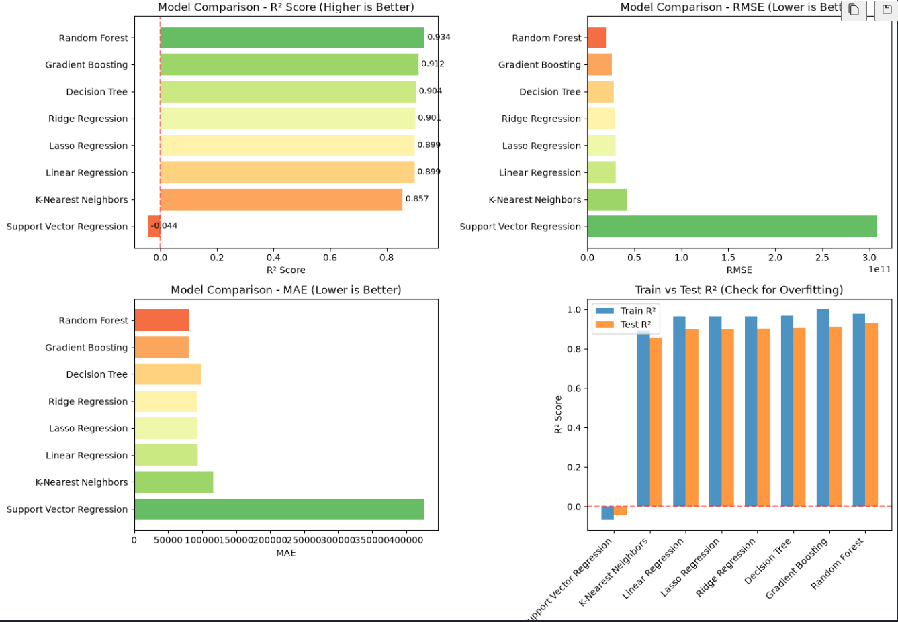
Model results evidences

Slide 23
Performance metrics for Random Forest
(best model)
93.4%
14.9%
25%
R² Score: 0.934
(2.dp rounded off)
RMSE: 19.6 billion, rounded off
MAE: 81.3 k,
rounded off

Slide 24
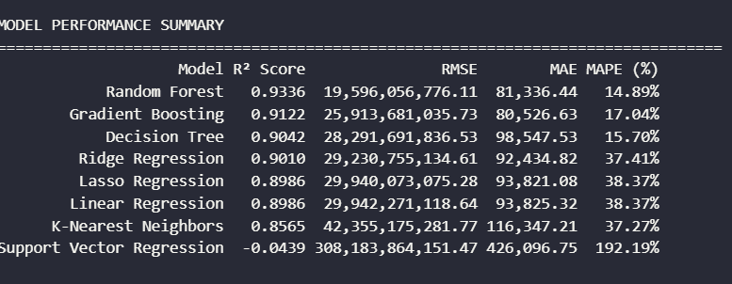
Performance Metric evidences

Slide 25
Most Important Findings
Past arrivals predict future arrivals.
Trends beat spikes. Moving averages are the top features.
Supply-demand matters. Crowded hotels signal strong demand.
Revenue confirms activity. Hotel revenue is a useful indicator.
Singapore is year-round. Seasonality is less important.

Slide 26
Conclusion
My approach to doing this project code
I would want to understand what each line of code means when I don’t understand and how it helps in my overall project. I would do markdown cells below each cell that has lines of code I don’t understand. I would ask the AI to explain to me in the simplest way first, and link it to what I have learn so far, or real life concepts
Improvements from my work
I managed to fix directory error of my csv files to everybody can view. I removed the r’ from every csv copied path. I removed NaN values from Test_R2 column to be able to run and do calculations for rest of the code.

Slide 27
Conclusion (for project)
This project successfully built a Random Forest model that predicts international visitor arrivals to Singapore with 93.4% accuracy for STB, proving that past tourism trends and hotel capacity constraints are the most powerful drivers of future arrivals.
By engineering features like moving averages, lagged arrivals, and supply-demand ratios, the model captures both momentum and crowding pressure—offering the Singapore Tourism Board a practical tool for short-term forecasting and capacity planning.
Future improvements like real-time data and deep learning can further enhance predictions and support data-driven decision-making for Singapore's tourism sector.

Slide 28



